Slide 1
Lack of Medical Care for Yemeni Children
Diane I. Ghanem

Slide 2
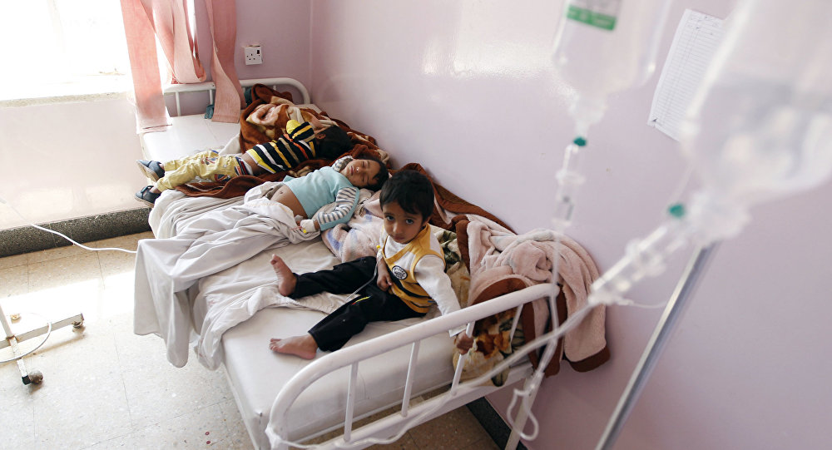
Lack of Medical Care for Yemeni Children
Diane I. Ghanem

Slide 3

Outline
Situation overview
Factors contributing to the lack of access to medical care for Yemeni children
Infrastructure breakdown
Crisis illness
Cholera outbreak
Current interventions

Slide 4
Outline
The “YeMed” plan
How much do you know about YeMed?
References

Slide 5
Definition
“Health Care is the maintenance and improvement of physical and mental health, especially through the provision of
Merriam Webster dictionary
medical services.”

Slide 6
Outline
Situation overview
Factors contributing to the lack of access to medical care for Yemeni children
Infrastructure breakdown
Crisis illness
Cholera outbreak
Current interventions

Slide 7
Situation overview
Yemen’s pre-conflict situation
Yemen’s conflict situation: world’s single largest humanitarian crisis
  affecting 91% of Yemen’s cities
  triple threat

Slide 8
Situation overview
War
Famine
Triple threat
Cholera

Slide 9
Situation overview
Yemen’s pre-conflict situation
Yemen’s conflict situation: world’s single largest humanitarian crisis
  affecting 91% of Yemen’s cities
  triple threat
8.1 million Yemeni children lack access to basic healthcare

Slide 10
Situation overview
“Every 10 minutes, at least one child dies of preventable causes like diarrhea, malnutrition and respiratory tract infections.” – UNICEF

Slide 11
Outline
Situation overview
Factors contributing to the lack of access to medical care for Yemeni children
Infrastructure breakdown
Crisis illness
Cholera outbreak
Current interventions

Slide 12
Outline
Situation overview
Factors contributing to the lack of access to medical care for Yemeni children
Infrastructure breakdown
Crisis illness
Cholera outbreak
Current interventions

Slide 13
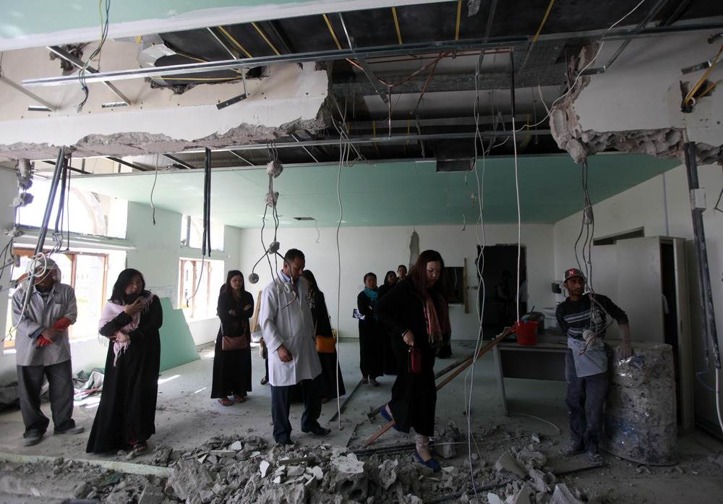
Infrastructure breakdown

Slide 14
Infrastructure breakdown
Availability of operating health facilities in Yemen
Suboptimal healthcare
Shortage of medical supplies
Shortage of qualified personnel

Slide 15
Outline
Situation overview
Factors contributing to the lack of access to medical care for Yemeni children
Infrastructure breakdown
Crisis illness
Cholera outbreak
Current interventions

Slide 16
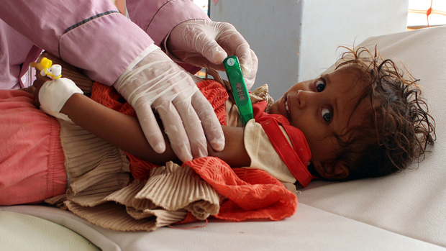
Crisis illness

Slide 17
Crisis illness
Lack of access to basic services
Spreading of treatable and preventable diseases
Increasing rates of malnutrition
  60% considered “food insecure”
  3.3 million nursing women and children severely malnourished

Slide 18
Outline
Situation overview
Factors contributing to the lack of access to medical care for Yemeni children
Infrastructure breakdown
Crisis illness
Cholera outbreak
Current interventions

Slide 19
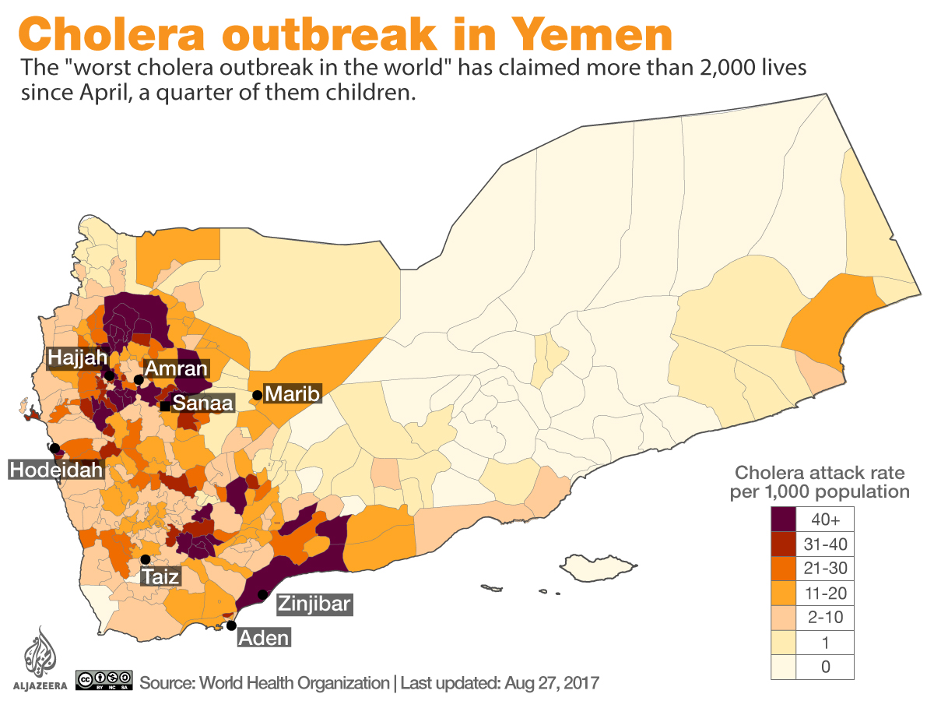

Slide 20
Cholera outbreak
Death of more than 2,000 Yemenis - 500 of which are children
Injury of more than 270,000 Yemenis
Perpetuation of a vicious cycle
Burst of the deadly cholera epidemic

Slide 21
Outline
Situation overview
Factors contributing to the lack of access to medical care for Yemeni children
Infrastructure breakdown
Crisis illness
Cholera outbreak
Current interventions

Slide 22
Current interventions
UN Children’s Fund (UNICEF)
World Food Program (WFP)
World Health Organization (WHO)
Doctors Without Borders – “Médecins sans frontières” (MSF)
Save The Children

Slide 23
Outline
The “YeMed” plan
How much do you know about YeMed?
References

Slide 24

The “YeMed” plan
Main Goal: Medical care access for all Yemeni children.
Scale up current responses and increase their efficiency while protecting the most vulnerable – the children.

Slide 25
Core Beliefs
Better Care
Better Value
Better Health

Slide 26
The “YeMed” plan
Main Goal: Medical care access for all Yemeni children.
Means:
  Implementing a radical strategy
  Reinforcing surveillance
  Expanding access to clean water and sanitation
  Expanding access to medical treatment
  Promoting awareness and prevention among the community

Slide 27
Outline
The “YeMed” plan
How much do you know about YeMed?
References

Slide 28


Slide 29

Psyc240C Students
$1,000,000
$500,000
$250,000
$125,000
The world’s single largest humanitarian crisis affects __ % of Yemen’s cities
$64,000
$32,000
$16,000
$8,000
$4,000
$2,000
$1,000
$500
A. 91%
B. 93%
$400
$300
$200
C. 95.7%
D. 98.8%
$100

Slide 30
Psyc240C Students
$1,000,000
$500,000
$250,000
$125,000
___ million Yemeni children lack access to basic health care.
$64,000
$32,000
$16,000
$8,000
$4,000
$2,000
$1,000
$500
$400
A. 14.8
B. 8.1
$300
C. 7.7
D. 12.8
$200
$100

Slide 31
Psyc240C Students
$1,000,000
$500,000
$250,000
Yemeni children are mostly dying from ______
$125,000
$64,000
$32,000
$16,000
$8,000
$4,000
$2,000
$1,000
$500
$400
A. Preventable illnesses
B. Cancer
$300
$200
C. Bombings
D. All of the above
$100

Slide 32
Psyc240C Students
$1,000,000
$500,000
$250,000
$125,000
Cholera is more important than malnutrition since it is more severe.
$64,000
$32,000
$16,000
$8,000
$4,000
$2,000
$1,000
$500
$400
A. Of course.
B. No.
$300
C. Yes, sounds like it.
D. No, they feed into each other. It’s a cycle.
$200
$100

Slide 33
Psyc240C Students
$1,000,000
$500,000
$250,000
$125,000
Among YeMed’s core beliefs, there is
$64,000
$32,000
$16,000
$8,000
$4,000
$2,000
$1,000
$500
A. All answers are correct.
B. Better Health
$400
$300
$200
C. Better Value
D. Better Care
$100

Slide 34
Psyc240C Students
$1,000,000
$500,000
$250,000
YeMed strives to end the crisis
$125,000
$64,000
$32,000
$16,000
$8,000
$4,000
$2,000
$1,000
$500
$400
A. today
B. in a year
$300
$200
C. soon
D. one day
$100

Slide 35
Congratulations,
You Won !

Slide 36
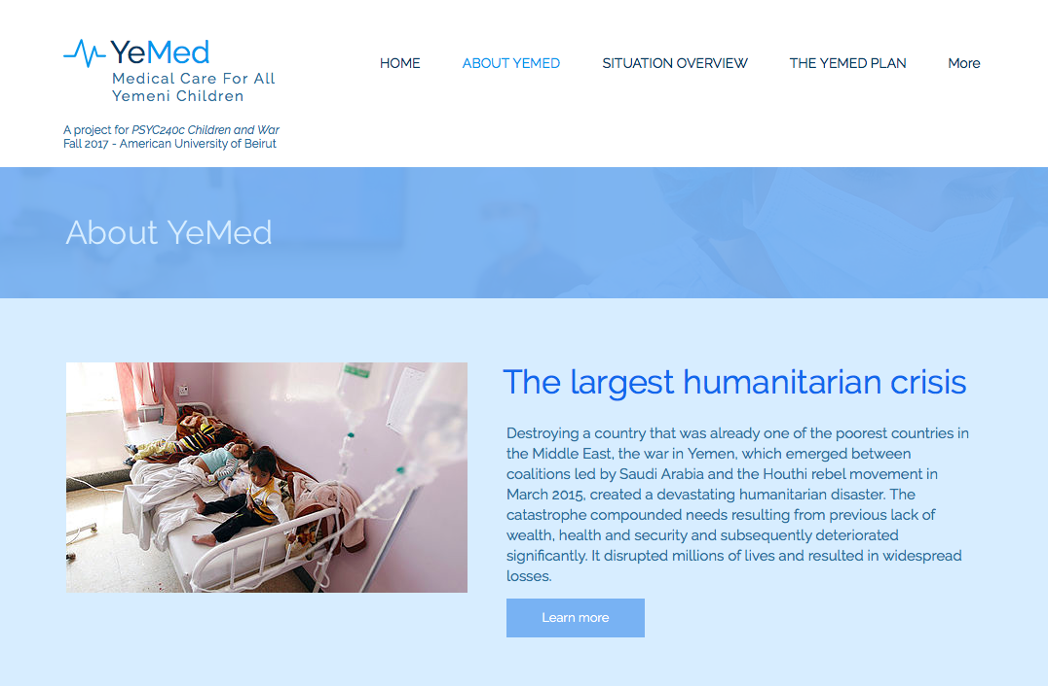
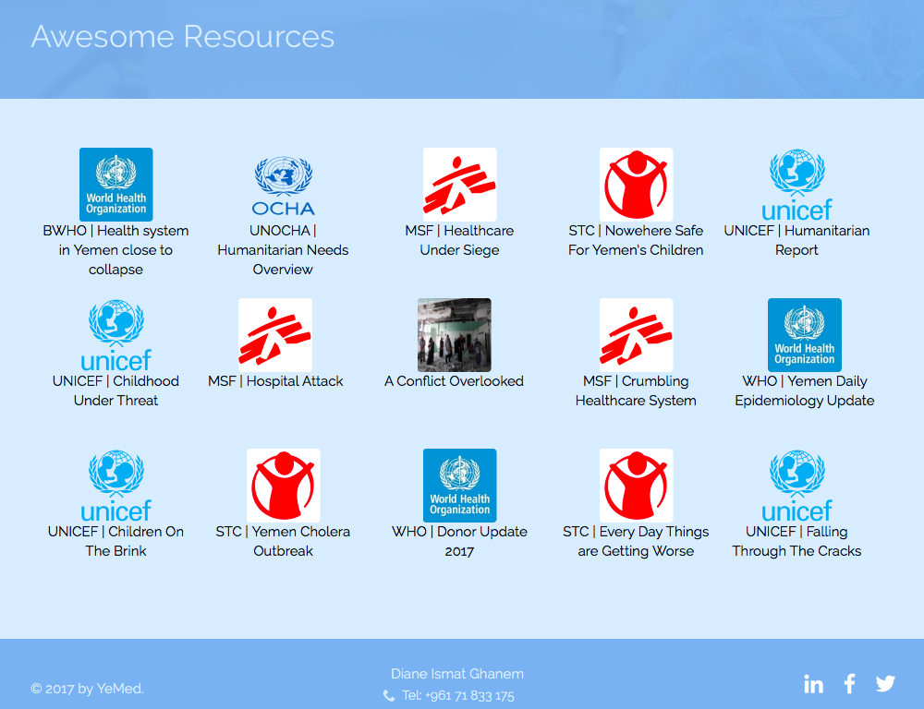
Still want to learn more?
Feel free to visit our website
dianeghanem.wixsite.com/yemed

Slide 37
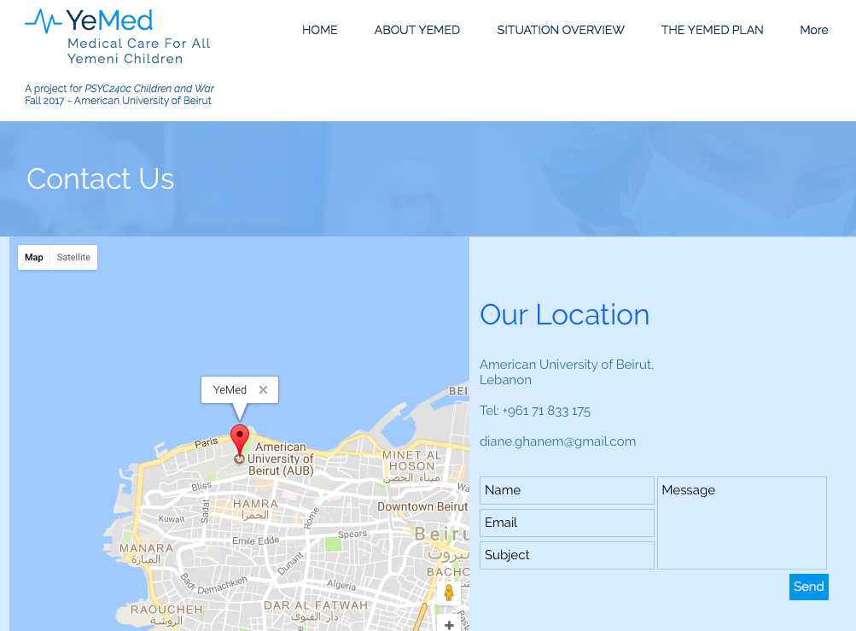
Still want to learn more?
Feel free to visit our website
dianeghanem.wixsite.com/yemed

Slide 38
Outline
The “YeMed” plan
How much do you know about YeMed?
References

Slide 39
References
Children on the Brink. (2016, March 29). Retrieved September 7, 2017, from http://www.unicef.org/media/files/Yemen_FINAL.PDF
Key facts about the war in Yemen. (2016, August 1). Retrieved September 8, 2017, from http://www.aljazeera.com/news/2016/06/key-facts-war-yemen-160607112342462.html
UN relief wing allocates $58 million for life-saving assistance in war-torn Yemen. (2016, December 09). Retrieved September 7, 2017, from http://www.un.org/apps/news/story.asp?NewsID=55765#.WbKd7mXsfwz
UNICEF Yemen Humanitarian Situation Report (March 2017). (2017, April 28). Retrieved September 7, 2017, from http://reliefweb.int/report/yemen/unicef-yemen-humanitarian-situation-report-march-2017

Slide 40
References
United Nations High Commissioner for Refugees. (n.d.). Yemen Emergency. Retrieved September 07, 2017, from http://www.unhcr.org/yemen-emergency.html
Yemen | Save the Children. (n.d.). Retrieved September 6, 2017, from https://yemen.savethechildren.net/
Yemen conflict: How bad is the humanitarian situation? (2017, March 28). Retrieved September 8, 2017, from http://www.bbc.com/news/world-middle-east-34011187
Yemen Crisis Regional Response. (2016, May 31). Retrieved September 8, 2017, from https://www.iom.int/sites/default/files/situation_reports/file/IOM-Yemen-Crisis-Regional-Response-Situation-Report-31-May-2016.pdf

Slide 41
References
Yemen: 'World's worst cholera outbreak' mapped. (2017, September 5). Retrieved September 07, 2017, from http://www.aljazeera.com/indepth/interactive/2017/06/yemen-world-worst-cholera-outbreak-mapped-170627110239483.html
Yemen: War in the time of cholera. (2017, August 16). Retrieved September 7, 2017, from https://www.icrc.org/en/document/yemen-war-time-cholera
Yemen. (2017, July 28). Retrieved September 8, 2017, from http://www.unicef.org/appeals/yemen.html
Yemen. (n.d.). Retrieved September 7, 2017, from http://www1.wfp.org/countries/yemen

